Slide 1



MITRON BANK
INSIGHTS TO PRODUCT STRATEGY TEAM
Presented by Pavani Bachina

Slide 2
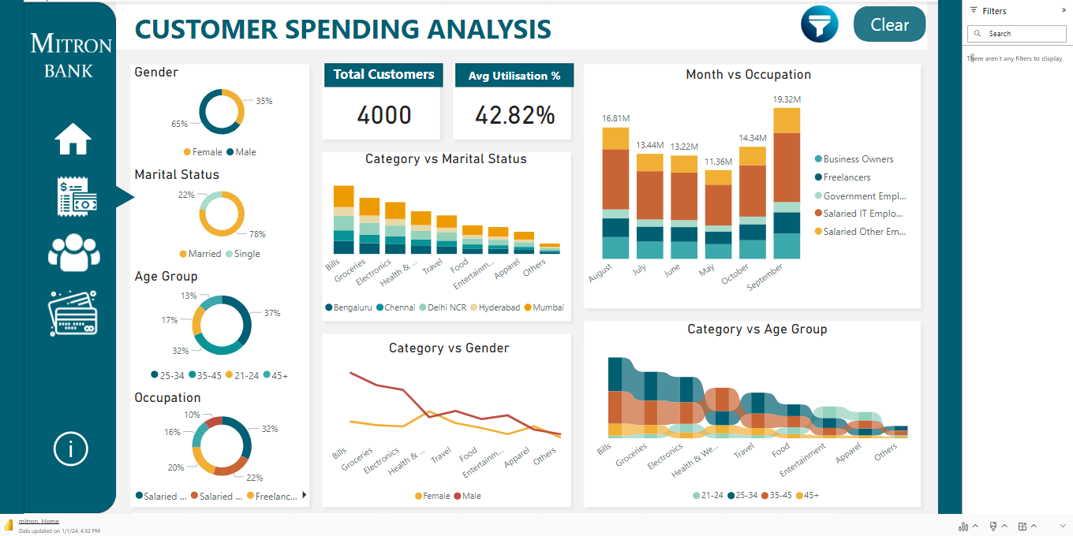
﻿Dashboard

Slide 3

﻿About
Mitron Bank is a legacy financial institution headquartered in Hyderabad. They want to introduce a new line of credit cards, aiming to broaden its product offerings and reach in the financial market.
AtliQ Data Services approached Mitron Bank with a proposal to implement this project.
Strategy director of Mitron Bank, Mr. Bashnir Rover asked them to do a pilot project with the sample data.

Slide 4
1
Average Income Utilization % = Average Spend / Average Income
﻿Key Metrics
2
Average Spend by Credit Card % = Average Spend by Credit Card / Average Spend

Slide 5
Demographics
Spending Analysis
Key Customers
Credit Card Analysis

Slide 6
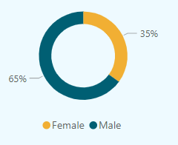
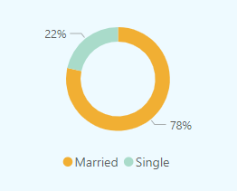
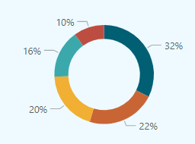
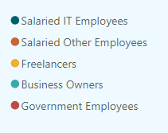
﻿Demographics
Gender
Marital Status
Occupation

Slide 7
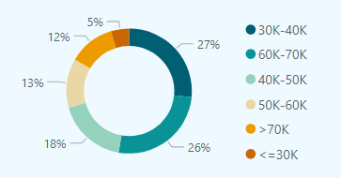
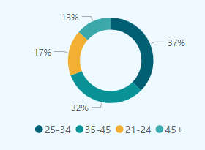
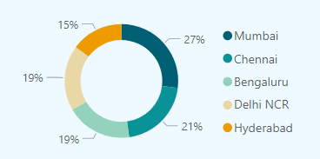
﻿Demographics
Average Income Range
Age Group
City

Slide 8

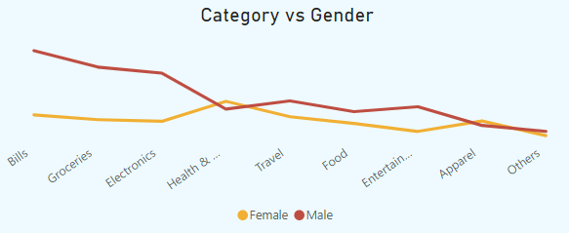
Spending Insights
The average revenue and expenditure for 4000 customers are 207M and 88.48M, respectively. 42.82% is the average utilization %. Customer spending is divided among numerous areas, including bills, groceries, apparels, food, and many others.
Women spend primarily on health & wellness, bills, and travel.
Bills, groceries, and electronics are the main expenses for males .
In terms of overall spending, men spend more than women.

Slide 9
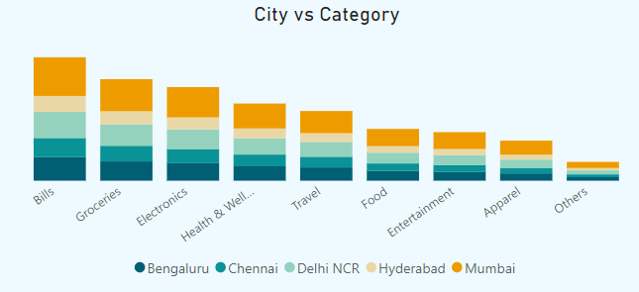
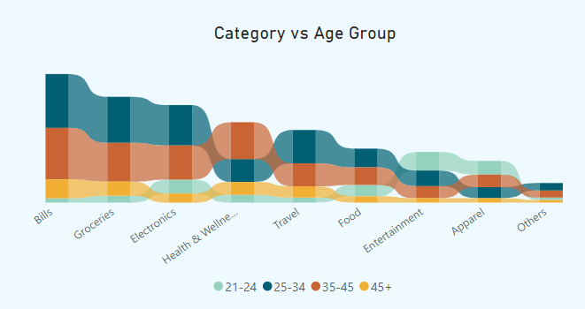
The majority of the expenses in every city are related to bills, groceries, electronics, and health & wellness.
The cities with the highest spending are Bengaluru (19%), Delhi (21%), and Mumbai (32%).
Spending is highest among the 25–34 age group (38%), followed by the 35–45 age group (36%).
The age group of 25 to 34 primarily spends money on travel, electronics, groceries, and bills. Bills, groceries, and health and wellness are the main expenses for the 35–45 age group.
The 21–24 age group spends most of its money on electronics, apparel, and entertainment. Spending by people over 45 is primarily on bills, groceries, and health and wellness.

Slide 10
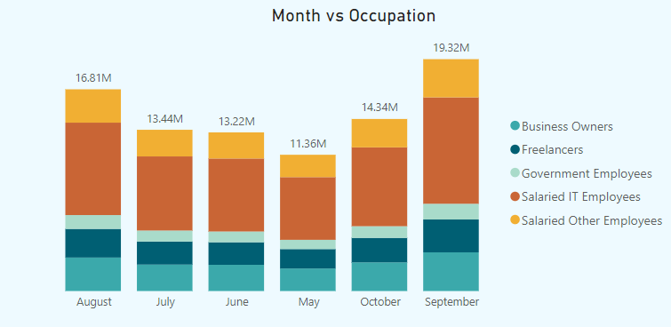
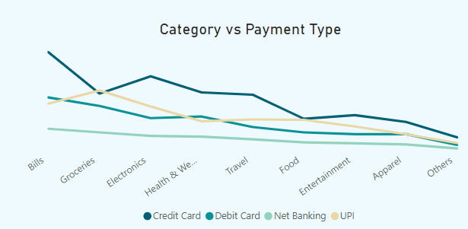
The largest spending month is September (22%), followed by August (19%) and October (16%).
It is evident that the majority of monthly spending is made by salaried IT employees, business owners and other salaried employees following closely after.
The most common payment methods are credit cards (41%), debit cards (22%), and UPI (26%).
Bills, electronics, and health & wellness are the categories where credit card usage is highest.
The majority of purchases done with UPI are for groceries, electronics, and bills.
Customers mostly use debit card for groceries, bills, health & wellness.

Slide 11
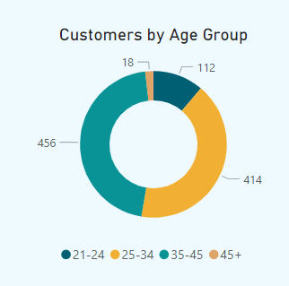
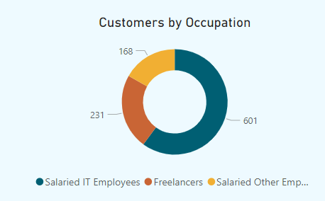
﻿Key Customers
We have taken into consideration the top 1000 customers out of 4000 based on average utilization percentage. The best customer's average usage is 77.37%, whereas the average utilization of these 1000 customers is 60%.

Slide 12
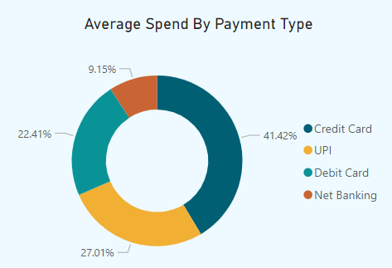
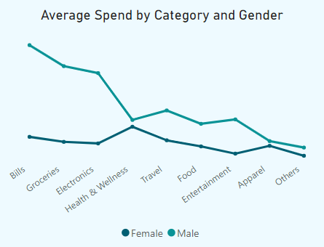
Credit cards are used for 41.4% of purchases. UPI accounts for 27% of transactions, whereas debit cards account for 22.4% of transactions.
The majority of the key customers are men, and they spend more than women do.
Bills, groceries, electronics, travel, and entertainment are the main expenses for males.
Women spend primarily on travel, bills, and health & wellness.
Spending on apparels and health & wellness is nearly equal for men and women.

Slide 13
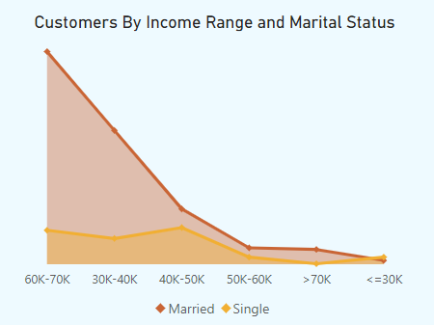
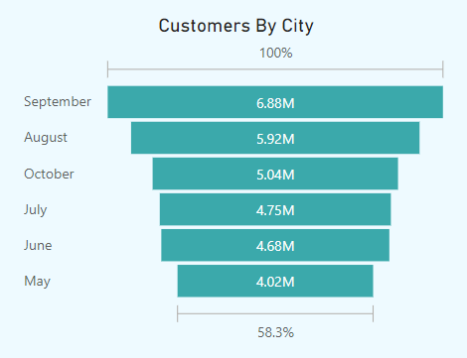
80% of the major customers are married.
About 60K–70K is earned by 49% of married key customers, and between 30K and 40K by 31%.
32 percent of single-key customers make between 40K-50K, while 31 percent make between 60K and 70K.
﻿
September (22%) is the month with the highest percentage of spending by key customers, followed by August (19%), October (16%), July (15%), June (15%), and May (13%).

Slide 14
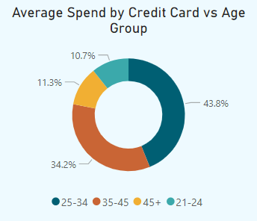
Credit Card Analysis
About 40.7% of the 88.48 million expenditures, or 36.05 million, are done with credit cards.
43.8% of the spending are made by 25–34 age group using credit cards. The second-highest age group, those between 35 and 45, uses credit cards for 34.2% of their total spending.
The 45+ age group uses credit cards for 11.3% of their purchases. With 10.7%, the age group 21–24 spends the least on credit cards.

Slide 15
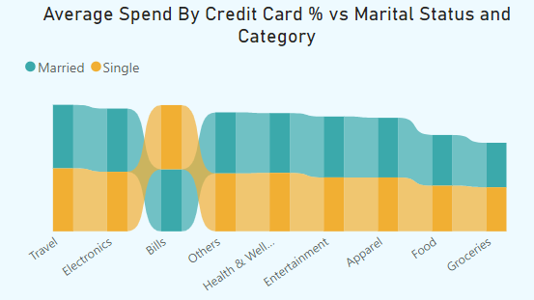
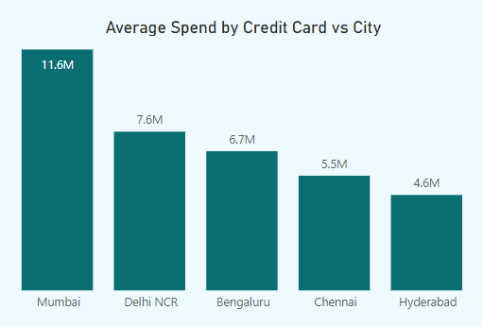
Customers with credit cards who are married and single spend approximately the same amount.
Customers who are married tend to spend slightly more than single customers. Customers who are single use their credit cards more frequently to pay their bill payments.
The majority of spending is on electronics and travel for both married and single customers.
Mumbai customers make up 32% of the spending, while Delhi customers make up 21%.
Customers in Bengaluru use credit cards for 19% of their purchases.
Chennai has the highest credit card spend % which is 41.5% followed by Delhi NCR with 41.1%.

Slide 16
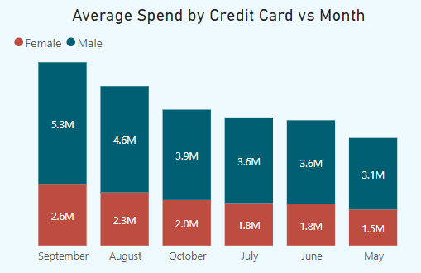
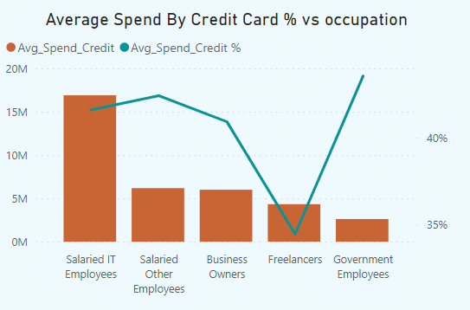
When using a credit card, men spend more than women do.
September was the month when customers, both male and female, spent more than they did in other months, with August and October coming next.
﻿
The people who use credit cards the most are paid IT employees, then other salaried staff, then business owners.
Government workers use credit cards the least compared to other consumers, but their utilization percentage—43.6%—is larger than that of other consumers.

Slide 17
CREDIT CARD FEATURE RECOMMENDATIONS

Slide 18
RECOMMENDATIONS BASED ON GENDER
Spending priorities might differ between men and women. Men may spend more on areas like technology and entertainment, while women may devote a larger portion of their credit card spending to categories like grocery, healthcare, and apparel.
Men may be more attracted to bonuses like travel advantages, whereas women may be more interested in cash back or discounts on regular purchases.
RECOMMENDATIONS BASED ON AGE GROUP
21-24: Individuals in this age group are young professionals and mostly single. They often have more discretionary income as they may not be financially responsible for a family.
25-34: This group may continue to use credit cards to build their credit profiles. They are earning more, they may use credit cards for everyday expenses, travel, and entertainment.
35-45: Individuals in this age group may use credit cards for family-related expenses, such as education, home improvement, and larger purchases. Many in this age range may be interested in accumulating credit card rewards for travel or cash back.
45+: Credit cards can be used to pay for bills, groceries, and medical costs associated with the family. People in the 45+ age group may utilize credit cards for travel and leisure activities since they may have greater discretionary income.

Slide 19
FEATURE RECOMMENDATIONS
Reward Program
Introductory Offers
No Annual Fees
Contactless Payments
Provide a rewards program where each purchase earns you miles, points, or cash back. Tailor the rewards to align with common spending categories such as groceries, dining, or travel.
Offer attractive introductory deals, such 0% APR on purchases or balance transfers for a certain period of time. This may draw in new customers and motivate current cardholders to use their cards more often.
Eliminating the annual fee has the potential to increase consumer appeal for the credit card. Cards without annual fees are preferred by many customers, particularly those who do not use the card regularly.
In the age of digital payments, include contactless payment solutions like NFC technology to speed up and simplify transactions.

Slide 20
FEATURE RECOMMENDATIONS
Mobile App Features
Security Feature
Personalized Offers
Customer Service
Add more functionalities to the credit card's mobile app, such real-time transaction notifications, tools for tracking spending and budgeting, and the option to temporarily freeze or unlock the card for security reasons
Provide sophisticated security features that allow customers to establish personalized spending limits and limitations, as well as fraud prevention and biometric verification (facial or fingerprint recognition).
Personalized offers and discounts can be given depending on the cardholder's purchasing habits by using data analytics.
With round-the-clock assistance, courteous customer service agents, and simple access to account information, you can guarantee great customer service.

Slide 21
﻿THANK YOU

